Slide 1
Traffic Homicide Investigations
DO’S AND DON’TS
SLOW DOWN!
Notes:
BEGINS 01:00 PM

Slide 2
OKLAHOMA STATISTICS
2019 – 640 FATALITIES
2018 – 655 FATALITIES
2017 – 657 FATALITES
2020 – 602 crashes resulting in 654 deaths
1,700 crashes resulted in 2,389 sustained “serious” injures
At least 77 fatality collisions were as a direct result of DUI (12%)
Notes:
NEXT SLIDE BY 01:05

Slide 3
CHARGEABLE? (It’s more than just checking a box)
There are no accidents…
There are Unintentional Collisions. There is always an ACT; Therefore an INTENT. The outcome is Unintentional.
So that leaves us with;
Chargeable vs non-chargeable OR Homicide Investigation…
Keep an open mind. Just like Criminal Interdiction traffic stops, there is typically other crimes afoot during a collision. So pay attention to detail.
The rabbit hole
Notes:
NEXT SLIDE BY 01:15 PM
Single vehicle with 20 year old fatality who is drunk
Pauls Valley collision where it appeared as single vehicle but later was signal 89

Slide 4
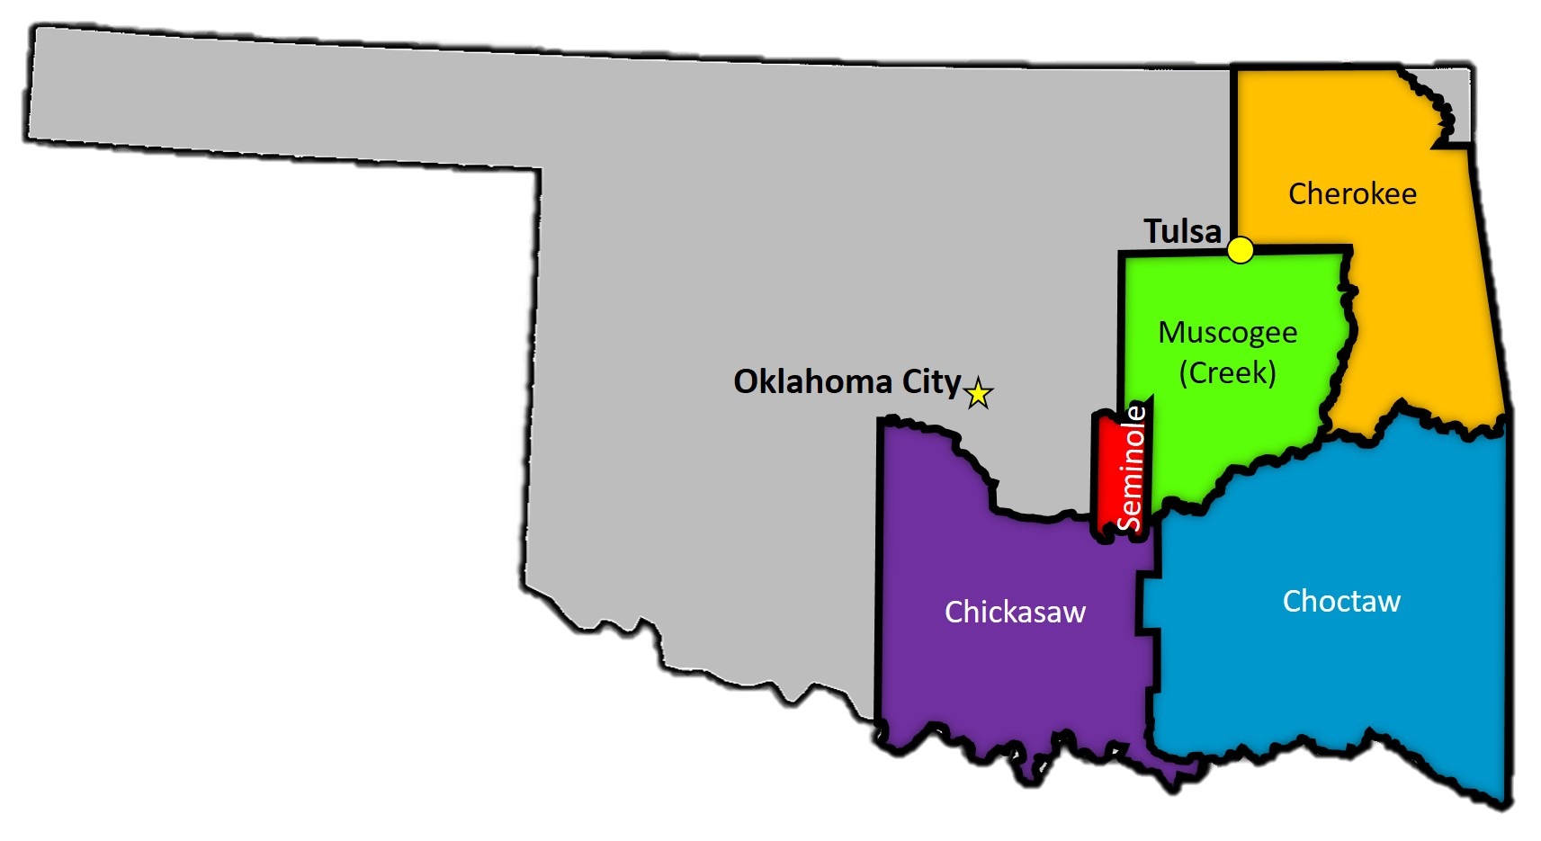
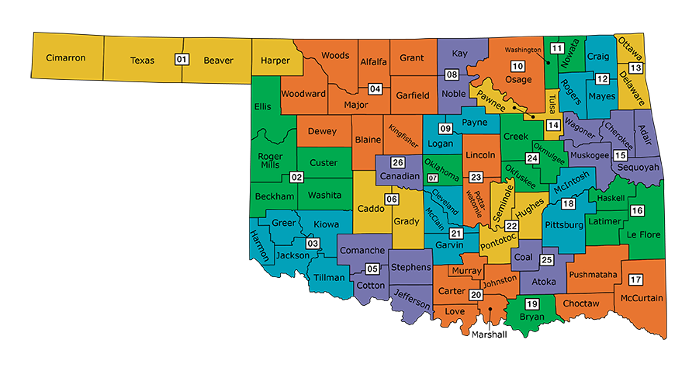
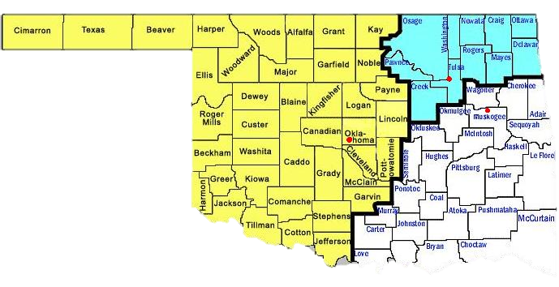
JURISDICTION
McGirt
State/Federal/Tribal
Good Faith—Keep it Good
Consent / Exigency / Search Warrants
Cases may begin in one Court and end in another
Notes:
NEXT SLIDE BY 01:20 PM
Bulla and Girty case – Charged in Chickasaw and indicted by Feds

Slide 5
ONE CHANCE
Witnesses (Anyone at the scene)
“Who are you and Why are you here?”
Video Evidence…It is Everywhere!!! (time/proper collection)
Blood
Debris
Marking with paint
Pictures (cannot take too many!)
Towing vehicles (Wrecker yard security)
Post Vehicle Inspection in controlled environment
***THE BIG THREE – BLOOD, WITNESSES AND PHOTOGRAPHS***
Notes:
NEXT SLIDE BY 01:30 PM

Slide 6
BLOOD EVIDENCE
It is SUPER IMPORTANT!!!
EMS blood draws vs hospital which is better?
Watch for basic mistakes (loss of vacuum, needle gauge, expired kits)
Out of State blood draws
Notes:
NEXT SLIDE BY 01:40 PM

Slide 7
THU AND YOUR AGENCY
Basic Collision Investigation consulting
Aerial photographs / Scene Diagrams
Crash Reconstruction
Search Warrants
EDR imaging
Infotainment
Issues with EMS blood draws
4 hour or more CLEET class training / Intro to traffic death
Future classes – Search Warrants etc.
Other investigations not involving a collision
Notes:
NEXT SLIDE BY 01:55 PM

Slide 8
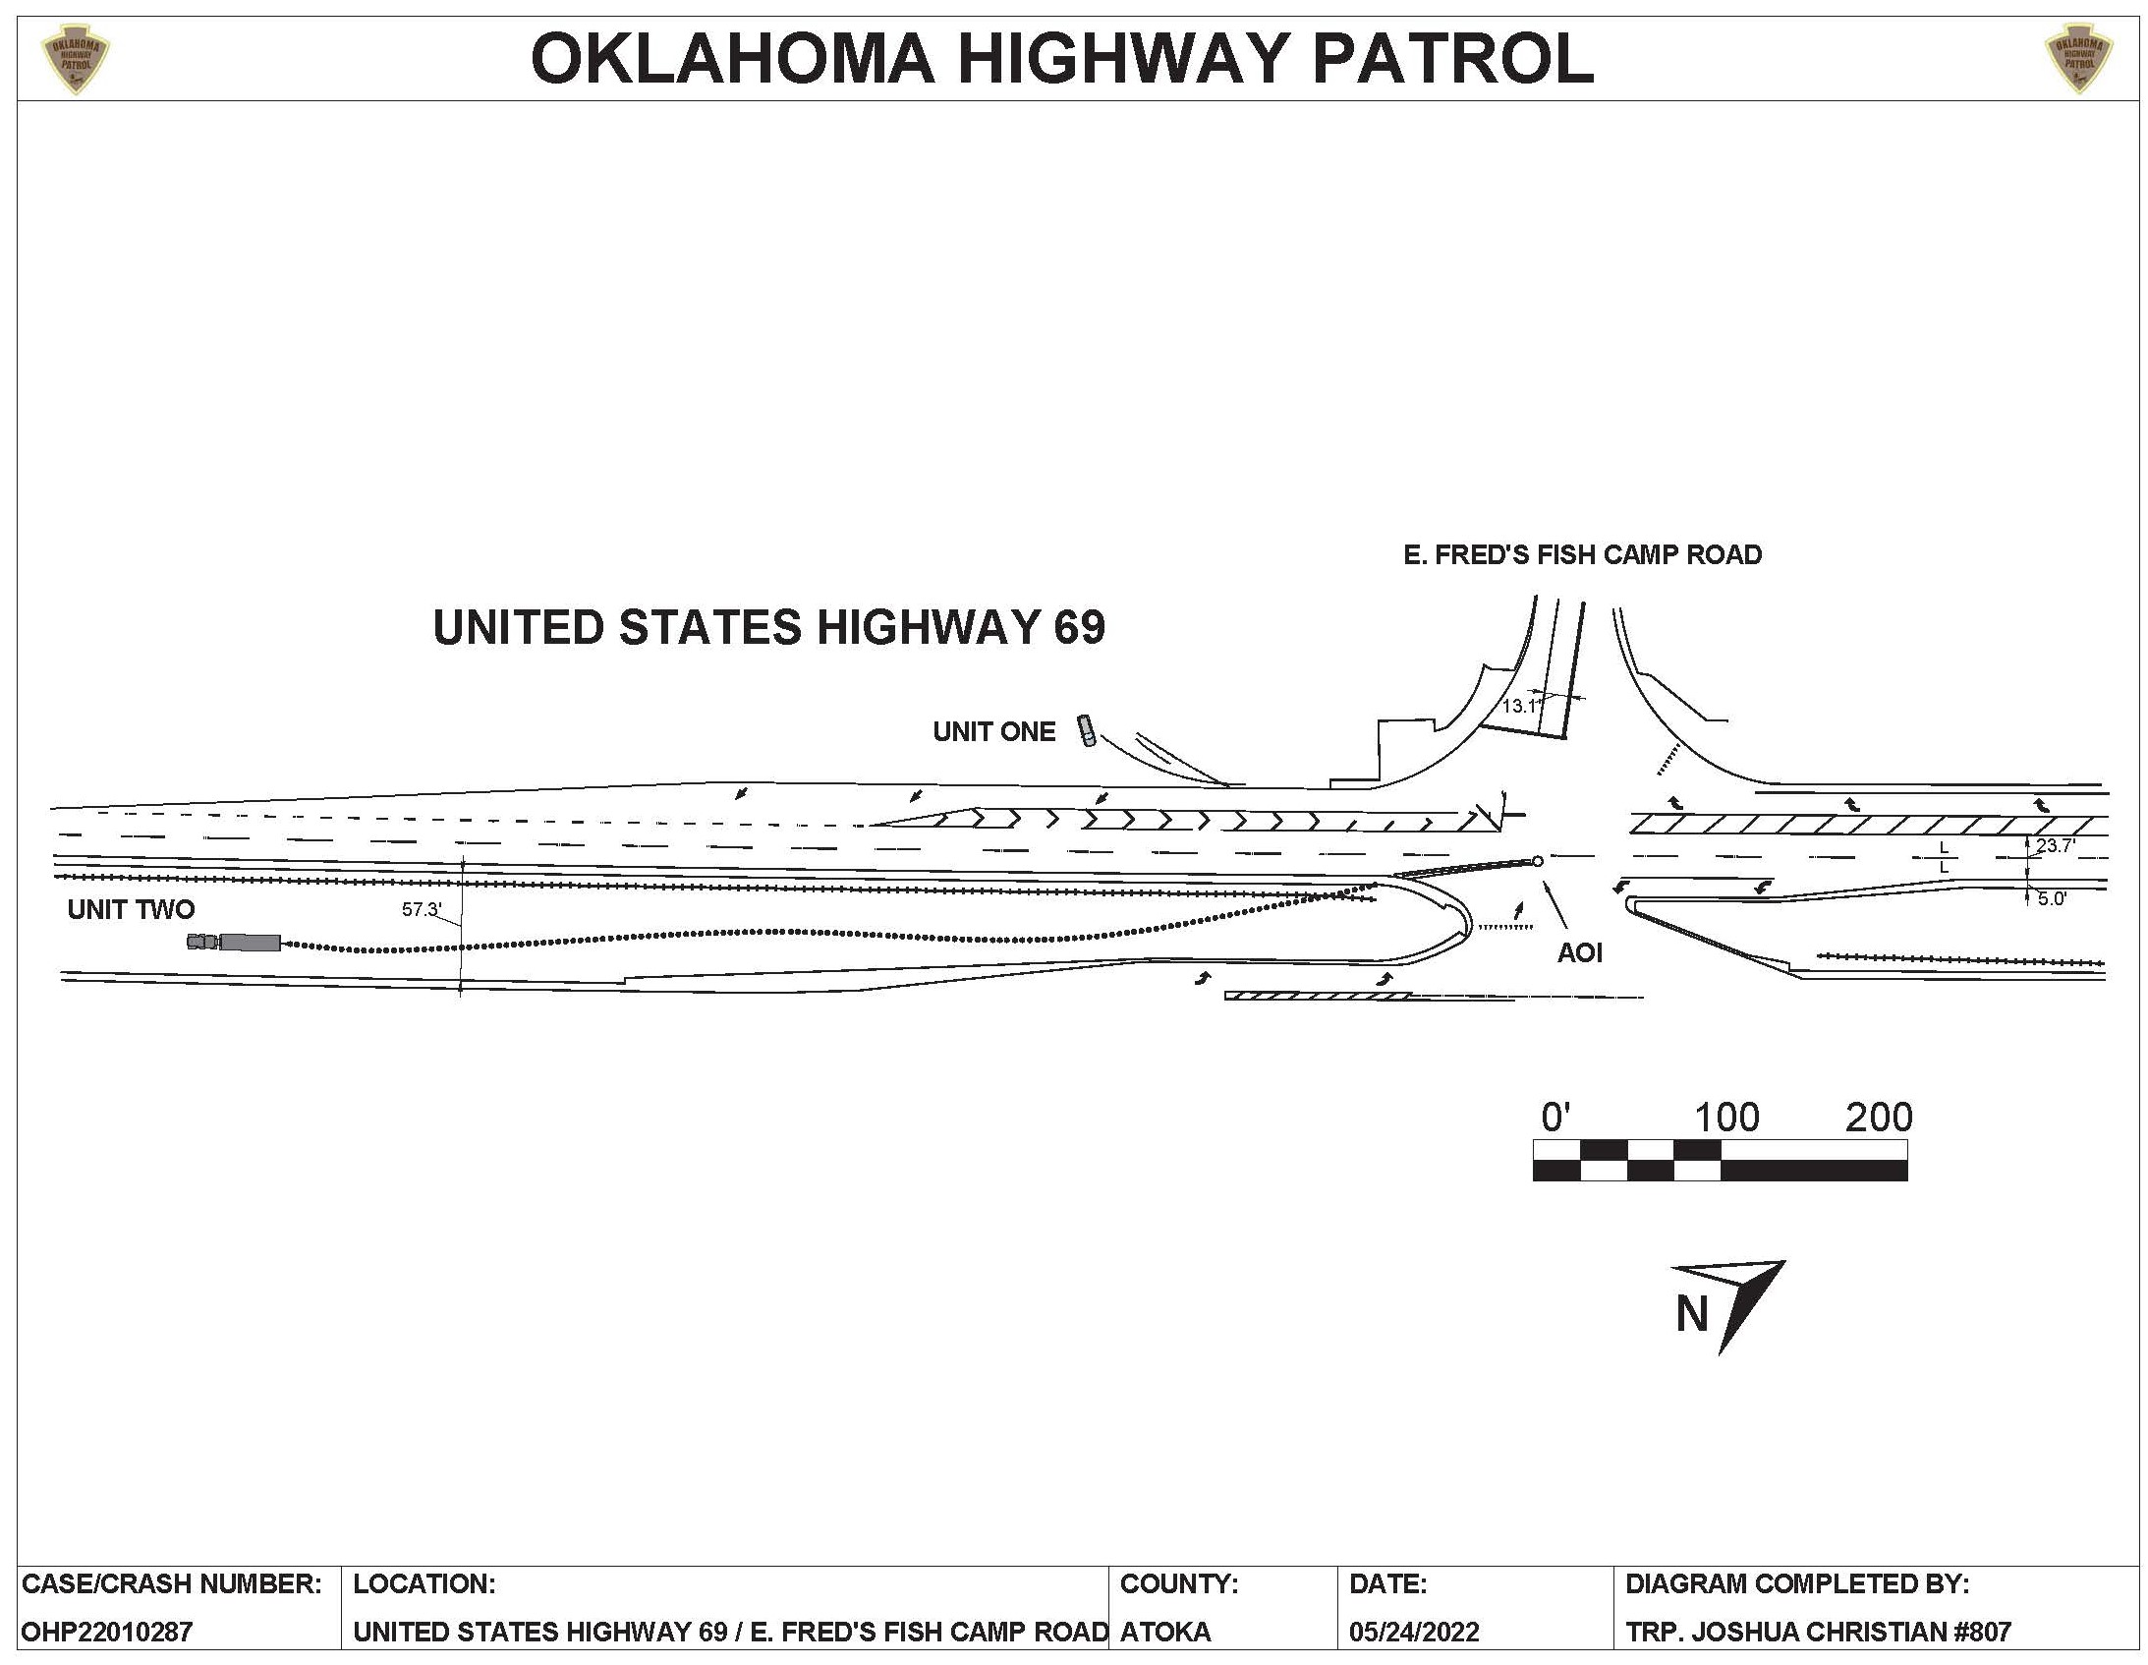
DIAGRAMS

Slide 9
DRONES

Slide 10
Perspective photography

Slide 11
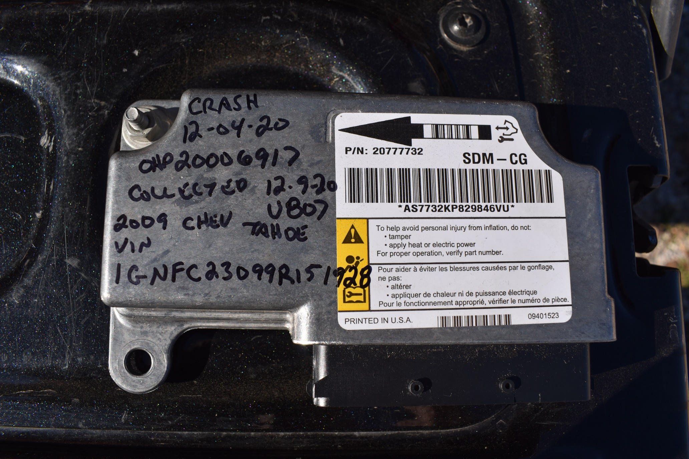
EVENT DATA RECORDERS

