Slide 1
988 MENTAL HEALTH LIFELINE
www.988oklahoma.com

Slide 2
www.988oklahoma.com
The purpose
Of 988
Provide a comprehensive crisis response continuum that enhances services Oklahomans receive when experiencing a psychiatric emergency.
The GOAL
Of 988
Oklahoma’s Comprehensive Crisis Response Continuum is an evidence-based approach to helping us reach the goal of meeting people where they’re at, when they need it most.

Slide 3
Ron Sims, MA LADC/MH
www.988oklahoma.com
Executive Director OCCIC/OCRU/ Senior Director of Ciris and Residential Services Department of Mental Health and Substance Abuse Services

Slide 4
Agenda
What is 988?
How it works - Solari Call Center
How 988 will impact Oklahomans
Urgent Recovery & Crisis Centers
Resources
Q&A

Slide 5
www.988oklahoma.com

Slide 6
www.988oklahoma.com

Slide 7
solari Call center
www.988oklahoma.com
Providing crisis line services since 2007
Nationally accredited
Headquartered in Tempe, Arizona
Solari’s Arizona crisis call center is the largest by volume in the country - taking 20,000 calls per month
Bringing 31 jobs to Oklahoma
Thrilled to be partnering with ODMHSAS to expand crisis services in Oklahoma!

Slide 8
Video
Notes:
When playing the video via Zoom, make sure you check the “Share sound” box so the audience can hear from your computer.

Slide 9
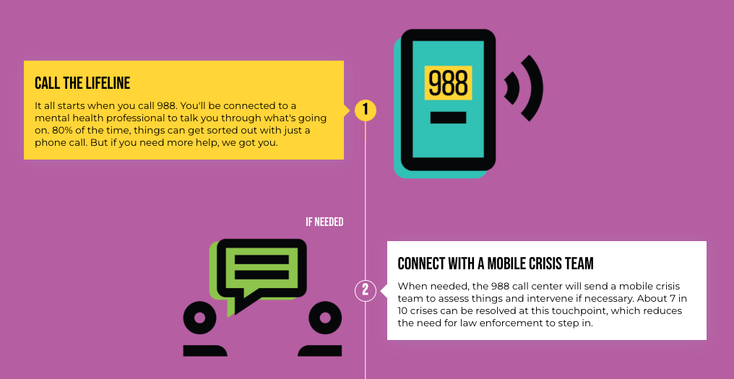
How it works:
www.988oklahoma.com

Slide 10
www.988oklahoma.com

Slide 11
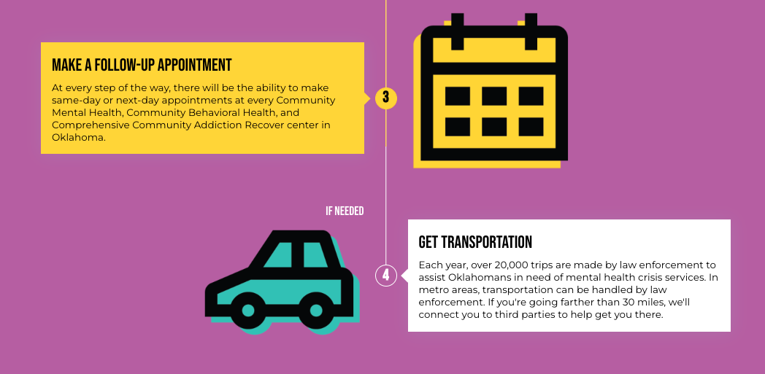
www.988oklahoma.com

Slide 12
www.988oklahoma.com
Urgent Recovery & Crisis Centers.
Urgent Care and Crisis Centers:
A place of stabilization.
Offer a no wrong door access to mental health and substance use care.
Operation of these facilities are similar to a hospital emergency department that accepts all walk-ins, ambulance, fire and police drop-offs.
These facilities provide assessment and support, and are staffed 24/7/365 with a multidisciplinary team. This team includes but is not limited to psychiatrists, nurses, licensed behavioral health practitioners and peers with lived experience similar to the population served.

Slide 13
How 988 will impact OKLAHOMANS
www.988oklahoma.com
ODMHSAS is building a system to address the needs of Oklahomans when experiencing a psychiatric emergency.
CURRENT STATE OF CRISIS
4.1% of adults in Oklahoma had serious thoughts of suicide in the past year.
1 in 10 students reporting attempting suicide in the past 12 months.
Each week, approximately 300 Oklahomans are admitted for urgent care or crisis mental health services.
The COMPREHENSIVE CRISIS RESPONSE system is funded by multiple sources to include state, federal and reimbursement.
This system is leveraging existing pieces in the community and follows national standards and best practices.

Slide 14
resources
www.988oklahoma.com

Slide 15
Posters available today
www.988oklahoma.com

Slide 16
FOLLOW US
@988okla
@988okla
@988okla
@988okla
@OKLA988

Slide 17
www.988oklahoma.com
In your community
List upcoming events, murals, activities, etc. here
Do you have an event or program we should attend, participate in or be aware of for 988?
Contact Ashley@jones.pr

Slide 18
questions?.
www.988oklahoma.com

